Slide 1
jQuery
The Way to JavaScript and Rich Internet Applications

Slide 2
Introduction to jQuery
Why do I want it
  Rich Internet Applications (RIA)
  Dynamic HTML (DHTML)
How do I get it
  www.jquery.com
How can I learn it
  www.jquery.com
  docs.jquery.com
  www.visualjquery.com
  www.Jqueryfordesigners.com
  www.gscottolson.com/weblog/ - cheat sheet
  www.javascripttoolbox.com/jquery

Slide 3
Introduction to jQuery
Installation – You just download the latest jQuery version from www.jquery.com and put it in your website folder
  Can access via URL using CDN but our internet is not reliable.

Slide 4
5 Things jQuery Provides
Select DOM (Document Object Model) elements on a page – one element or a group of them
Set properties of DOM elements, in groups (“Find something, do something with it”)
Creates, deletes, shows, hides DOM elements
Defines event behavior on a page (click, mouse movement, dynamic styles, animations, dynamic content)
AJAX calls

Slide 5
The DOM
Document Object Model
jQuery is “DOM scripting”
Heirarchal structure of a web page
You can add and subtract DOM elements on the fly
You can change the properties and contents of DOM elements on the fly

Slide 6
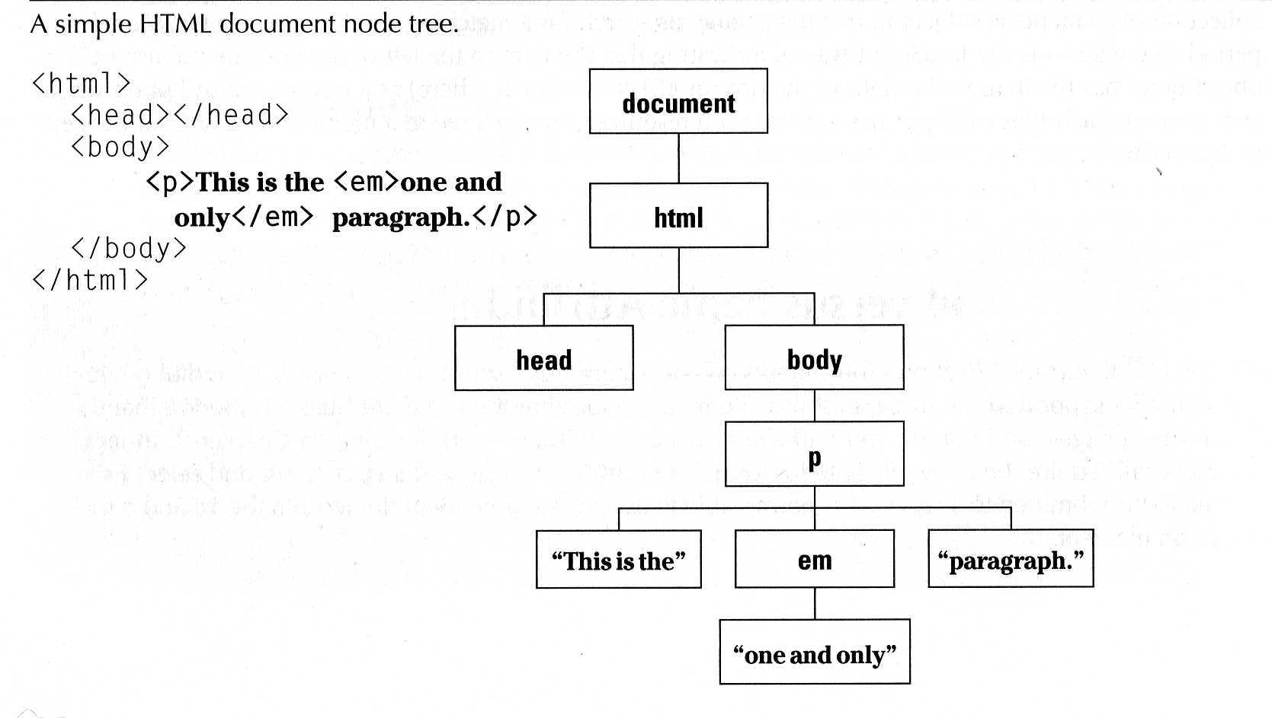
The DOM
“The Document Object Model (DOM) is a cross-platform and language-independent convention for representing and interacting with objects in HTML, XHTML and XML documents. Aspects of the DOM (such as its "Elements") may be addressed and manipulated within the syntax of the programming language in use.” Wikipedia

Slide 7
The jQuery Function
jQuery() = $()
$(function) The “Ready” handler
$(‘selector’) Element selector expression
$(element) Specify element(s) directly
$.function() Execute a jQuery function

Slide 8
Tutorial 1 – The Ready Function
Set up a basic HTML page and add jQuery
Create a “ready” function
Call a function
5 ways to specify the ready function
  jquery(document).ready(function(){…};);
  jquery().ready(function(){…};)
  jquery(function(){…};)
  jquery(dofunc);
  $(dofunc);

Slide 9
Tutorial 2 – Selecting Elements
Creating a “wrapped set”
$(selector)
selector:
  $(‘#id’) id of element
  $(‘p’) tag name
  $(‘.class’) CSS class
  $(‘p.class’) <p> elements having the CSS class
  $(‘p:first’) $(‘p:last’) $(‘p:odd’) $(‘p:even’)
  $(‘p:eq(2)’) gets the 2nd <p> element (1 based)
  $(‘p’)[1] gets the 2nd <p> element (0 based)
  $(‘p:nth-child(3)) gets the 3rd <p> element of the parent. n=even, odd too.
  $(‘p:nth-child(5n+1)’) gets the 1st element after every 5th one
  $(‘p a’) <a> elements, descended from a <p>
  $(‘p>a’) <a> elements, direct child of a <p>
  $(‘p+a’) <a> elements, directly following a <p>
  $(‘p, a’) <p> and <a> elements
  $(‘li:has(ul)’) <li> elements that have at least one <ul> descendent
  $(‘:not(p)’) all elements but <p> elements
  $(‘p:hidden’) only <p> elements that are hidden
  $(‘p:empty’) <p> elements that have no child elements

Slide 10
Selecting Elements, cont.
$(‘img’[alt]) <img> elements having an alt attribute
$(‘a’[href^=http://]) <a> elements with an href attribute starting with ‘http://’
$(‘a’[href$=.pdf]) <a> elements with an href attribute ending with ‘.pdf’
$(‘a’[href*=ntpcug]) <a> elements with an href attriute containing ‘ntpcug’

Slide 11
Useful jQuery Functions
.each() iterate over the set
.size() number of elements in set
.end() reverts to the previous set
.get(n) get just the nth element (0 based)
.eq(n) get just the nth element (0 based) also .lt(n) & .gt(n)
.slice(n,m) gets only nth to (m-1)th elements
.not(‘p’) don’t include ‘p’ elements in set
.add(‘p’) add <p> elements to set
.remove() removes all the elements from the page DOM
.empty() removes the contents of all the elements
.filter(fn/sel) selects elements where the func returns true or sel
.find(selector) selects elements meeting the selector criteria
.parent() returns the parent of each element in set
.children() returns all the children of each element in set
.next() gets next element of each element in set
.prev() gets previous element of each element in set
.siblings() gets all the siblings of the current element

Slide 12
Tutorial 3 – Formatting Elements
.css(property, value)
.html()
.val() (form elements)
.text()
.addClass(‘class’)
.removeClass(‘class’)

Slide 13
Tutorial 4 – Add Page Elements
$(‘#target’).before(‘<p>Inserted before #target</p>’);
$(‘#target’).after(‘<p>This is added after #target</p>’);
$(‘#target’).append(‘<p>Goes inside #target, at end</p>’);
$(‘#target’).wrap(‘<div></div>’);

Slide 14
Adding Events
Mouseover events – bind, hover, toggle
Button click events
Keystrokes

Slide 15
Event Background
DOM Level 2 Event Model
  Multiple event handlers, or listeners, can be established on an element
  These handlers cannot be relied upon to run an any particular order
  When triggered, the event propagates from the top down (capture phase) or bottom up (bubble phase)
  IE doesn’t support the “capture phase”

Slide 16
Basic Syntax of Event Binding
$(‘img’).bind(‘click’,function(event){alert(‘Howdy’;});
$(‘img’).bind(‘click’,imgclick(event));
  Allows unbinding the function
$(‘img’).unbind(‘click’,imgclick());
$(‘img’).unbind(‘click’);
$(‘img’).one(‘click’,imgclick(event));
  Only works once
$(‘img’).click(imgclick);
$(‘img’).toggle(click1, click2);
$(‘img’).hover(mouseover, mouseout);

Slide 17
Element Properties – “this”
this
this.id
this.tagName
this.attr
this.src
this.classname
this.title
this.alt
this.value (for form elements)

Slide 18
‘Event’ properties
event.target ref to element triggering event
Event.target.id id of element triggering event
event.currentTarget
event.type type of event triggered
event.data second parm in the bind() func
Various mouse coordinate properties
Various keystroke related properties

Slide 19
Event Methods
.stopPropagation() no bubbling
.preventDefault() no <a> link, no <form> submit
.trigger(eventType) does not actually trigger the event, but calls the appropriate function specified as the one tied to the eventType
.click(), blur(), focus(), select(), submit()
  With no parameter, invokes the event handlers, like trigger does, for all the elements in the wrapped set

Slide 20
Shortcut Event Binding
.click(func)
.submit(func)
.dblclick(func)
.mouseover(func)
.mouseout(func)
.select(func)

Slide 21
Useful Event Functions
.hide() display:true
.show() display:none
.toggle(func1, func2) first click calls func1, next click executes func2
.hover(over, out) mouseover, mouseout

